Slide 1
IoT based Unmanned Aerial Vehicle for Surveillance using Wireless Sensor Network
Kalyani Government Engineering College
KGEC/CSE/MTECH/2nd YEAR
Presented by
Shubham Khan
Under guidance of
Prof. Swapan Kumar Mondal
Final Year Postgraduate 2019-21
University Roll no : 10211219006
Page: i

Slide 2
Outline
KGEC/CSE/MTECH/2nd YEAR
Overview
Components Required
UAV Implementation
Hardware Implementation
Flight controller configuration
Developed object detection
Result
Test Flight
Discussion
Conclusion
Future work
References
July 05th, 2021
Page: ii

Slide 3
Overview
KGEC/CSE/MTECH/2nd YEAR
In simple words, this project is an unmanned aerial vehicle used for surveillance and it is remotely controlled by using a transmitter and receiver. It can also be used for human detection.
Where do we need this project?
Search and rescue.
Military application.
Product delivery.
News reporting.
Outline
July 05th, 2021
Page: 1

Slide 4
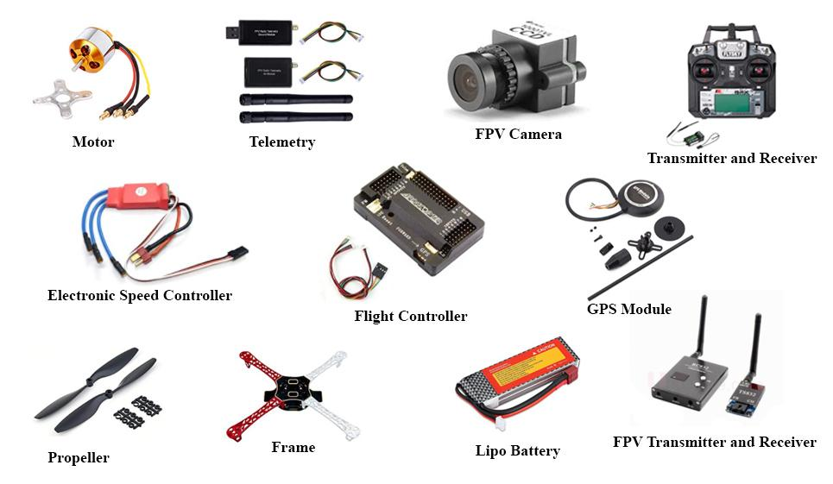
Components Required
KGEC/CSE/MTECH/2nd YEAR
Fig 1: Project Components
Outline
July 05th, 2021
Page: 2

Slide 5
UAV Implementation
KGEC/CSE/MTECH/2nd YEAR
Hardware Implementation
Flight controller configuration
Developed object detection
Outline
July 05th, 2021
Page: 3

Slide 6
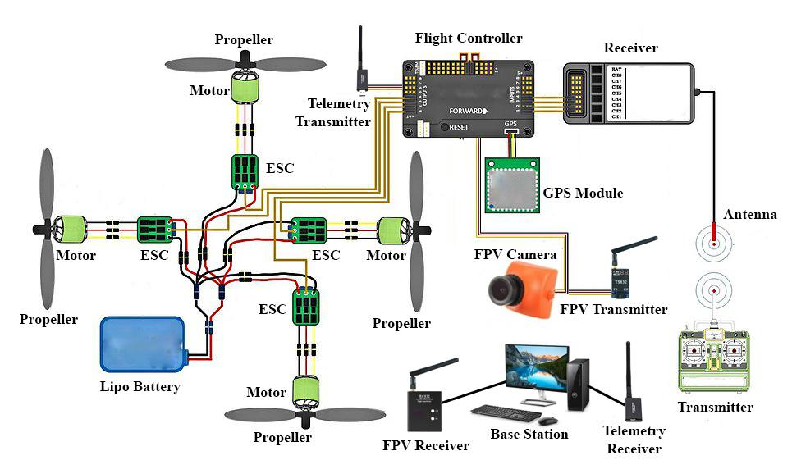
Hardware Implementation: Overview
KGEC/CSE/MTECH/2nd YEAR
Outline
Fig 2: Working Principle
July 05th, 2021
Page: 4

Slide 7
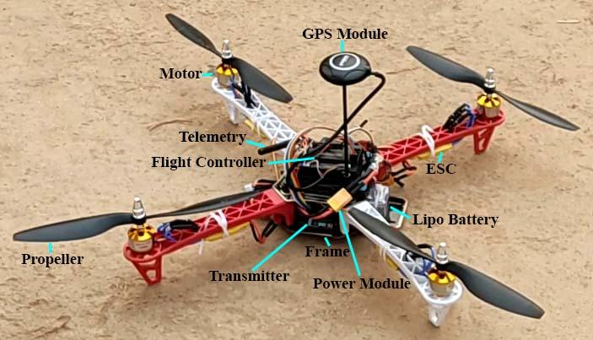
Hardware Implementation: Assembly
KGEC/CSE/MTECH/2nd YEAR
Outline
Fig 3: UAV Assembly
July 05th, 2021
Page: 5

Slide 8
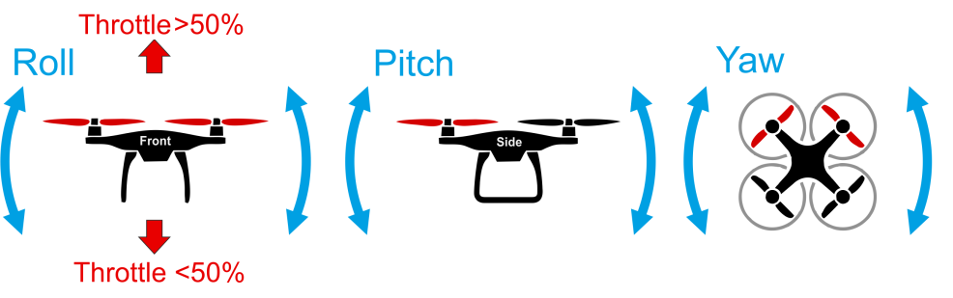
Hardware Implementation: UAVs action
KGEC/CSE/MTECH/2nd YEAR
Fig 4: Type of UAVs action
Roll: This helps move the UAV in the air to the left or right.
Pitch: This helps the UAV to move forward or backward.
Yaw: This helps the UAV to rotate clockwise or counterclockwise.
Throttle: This helps the UAV to move faster or slower.
Outline
July 05th, 2021
Page: 6

Slide 9
Flight Controller Configuration
KGEC/CSE/MTECH/2nd YEAR
Firmware Installing
ESC Calibration
Compass Calibration
Accelerometer Calibration
Radio Control Calibration
Flight Mode Configuration
Outline
July 05th, 2021
Page: 7

Slide 10
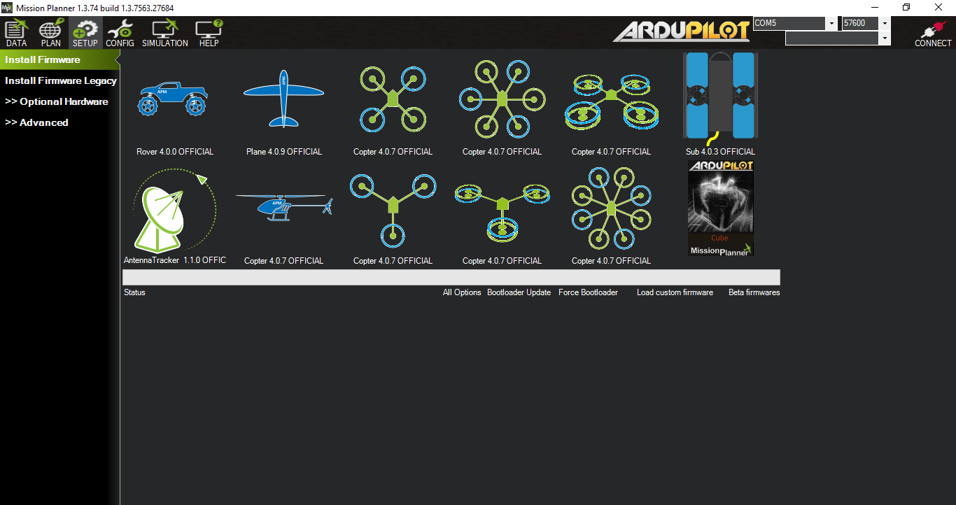
Firmware Installing
KGEC/CSE/MTECH/2nd YEAR
Outline
Fig 5: Firmware Installing
July 05th, 2021
Page: 8

Slide 11
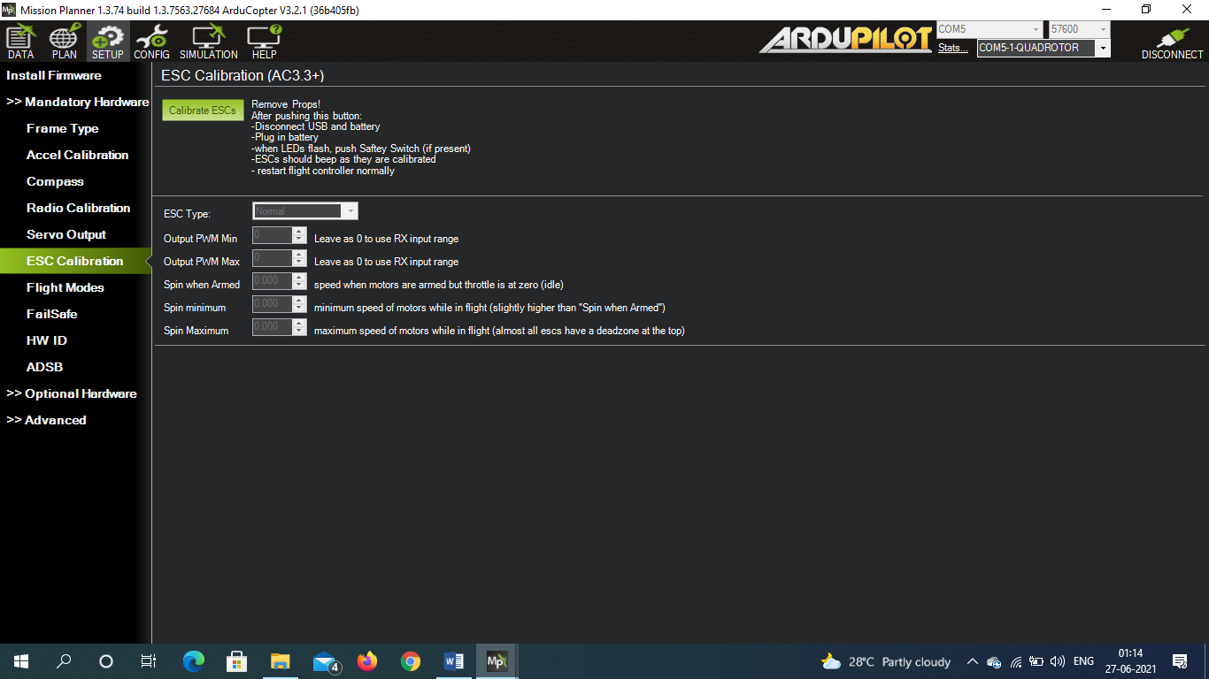
ESC Calibration
KGEC/CSE/MTECH/2nd YEAR
Outline
Fig 6: ESC Calibration
July 05th, 2021
Page: 9

Slide 12
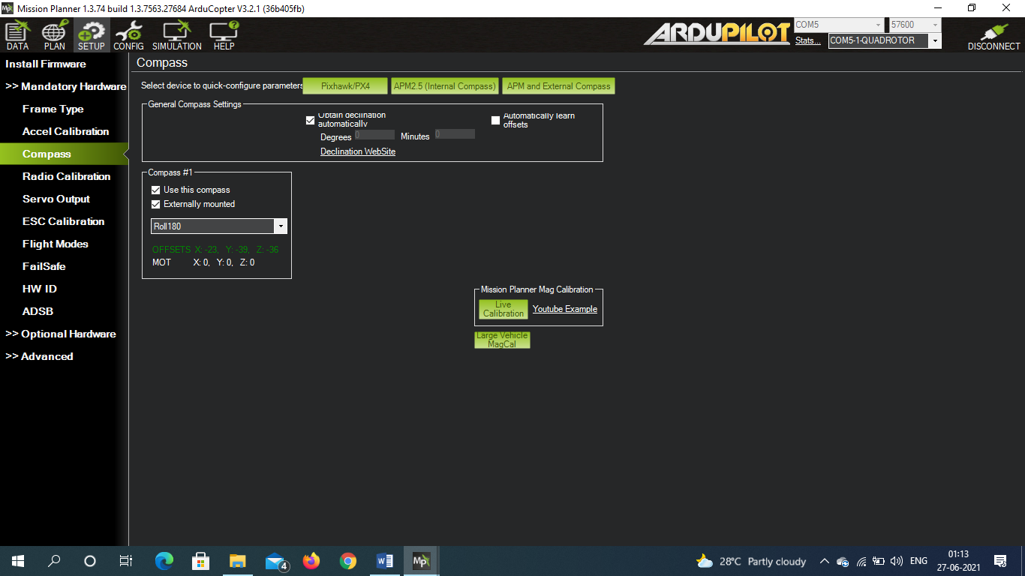
Compass Calibration
KGEC/CSE/MTECH/2nd YEAR
Outline
Fig 7: Compass Calibration
July 05th, 2021
Page: 10

Slide 13
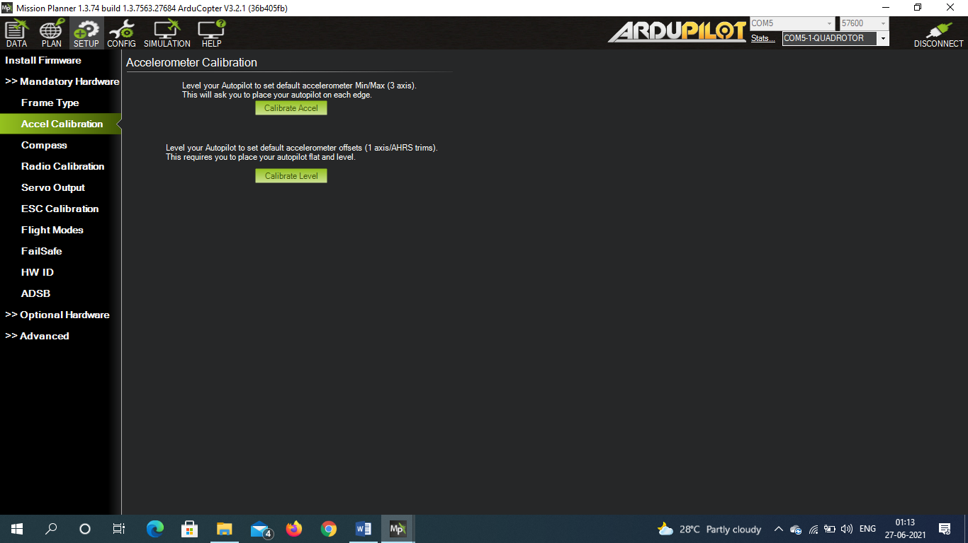
Accelerometer Calibration
KGEC/CSE/MTECH/2nd YEAR
Outline
Fig 8: Accelerometer Calibration
July 05th, 2021
Page: 11

Slide 14
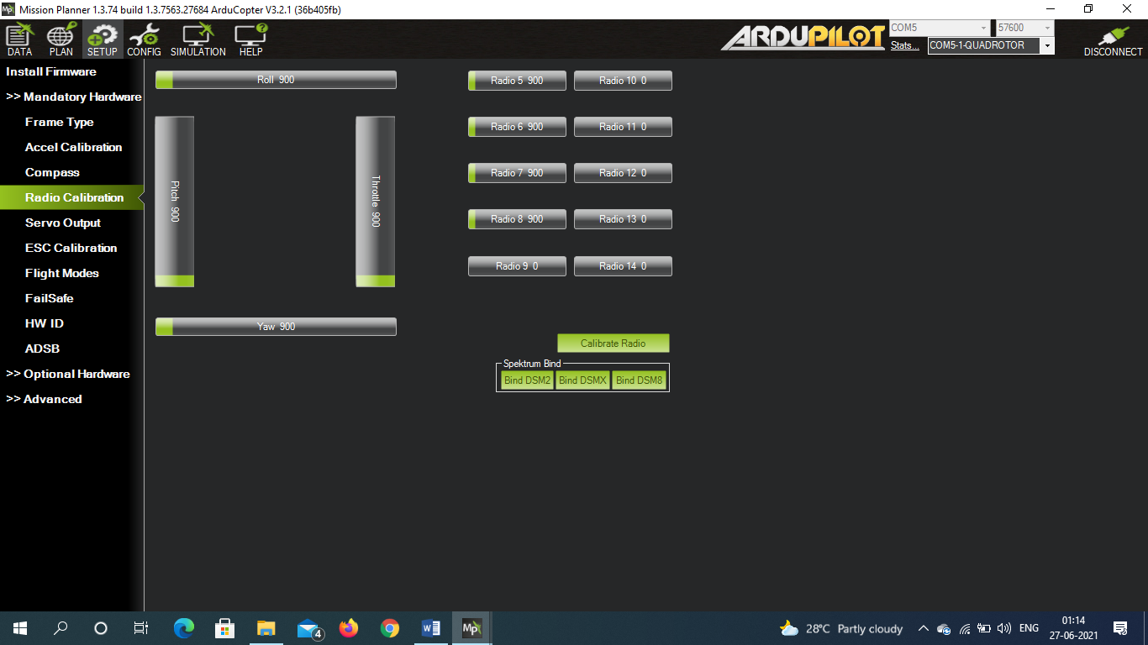
Radio Control Calibration
KGEC/CSE/MTECH/2nd YEAR
Outline
Fig 9: Radio Control Calibration
July 05th, 2021
Page: 12

Slide 15
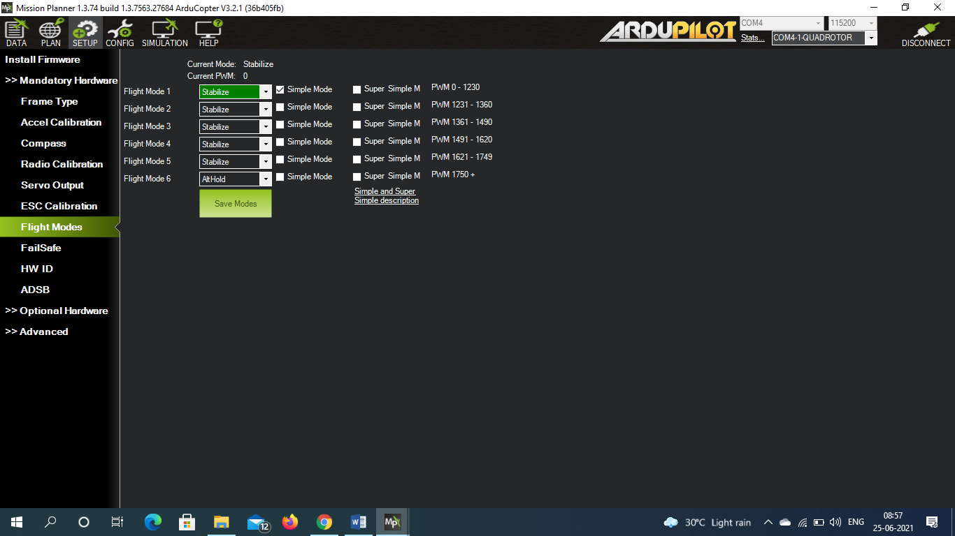
Flight Mode Configuration
KGEC/CSE/MTECH/2nd YEAR
Outline
Fig 10: Flight Mode Configuration
July 05th, 2021
Page: 13

Slide 16
Object detection
KGEC/CSE/MTECH/2nd YEAR
Choosing a pre-training model
Preprocessing Images and Labels
Generating TF record
Training and Testing
Outline
July 05th, 2021
Page: 14

Slide 17

Choosing a pre-training model
KGEC/CSE/MTECH/2nd YEAR
Fig 11: Basic architecture of CNN
Convolutional Neural Network (CNN) is a Deep Learning algorithm which can take in an input image, assign importance to various objects in the image and be able to differentiate one from the other. Here we choos Single Shot Detector (SSD) MobileNet for object detection.
Outline
July 05th, 2021
Page: 15

Slide 18
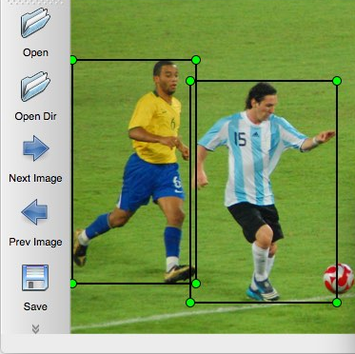
Preprocessing Images and Labels
KGEC/CSE/MTECH/2nd YEAR
Here we create an annotation file by using labelimg software use the bounding box technique to making rectangular boxes around similar objects.
Fig 12: Images labeling
Outline
July 05th, 2021
Page: 16

Slide 19
Generating TF record
KGEC/CSE/MTECH/2nd YEAR
Tensorflow accepts data in the form of TFRecords, a binary file that runs quickly and uses little memory. Instead of loading the entire data set into memory, Tenorflow uses these TFRecords to automatically divide the data into chunks.
Outline
July 05th, 2021
Page: 17

Slide 20
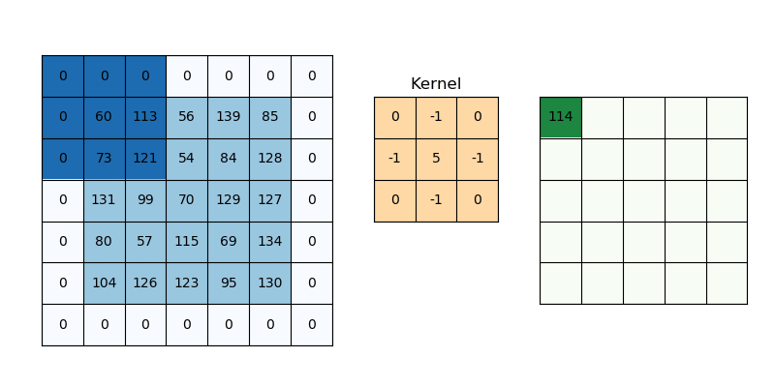

Training and Testing
KGEC/CSE/MTECH/2nd YEAR
Fig 13: Tranning process
Object detecation models train themselves in this technique.
Outline
July 05th, 2021
Page: 18

Slide 21
Result
KGEC/CSE/MTECH/2nd YEAR
Hardware result
Object detection result
Outline
July 05th, 2021
Page: 19

Slide 22
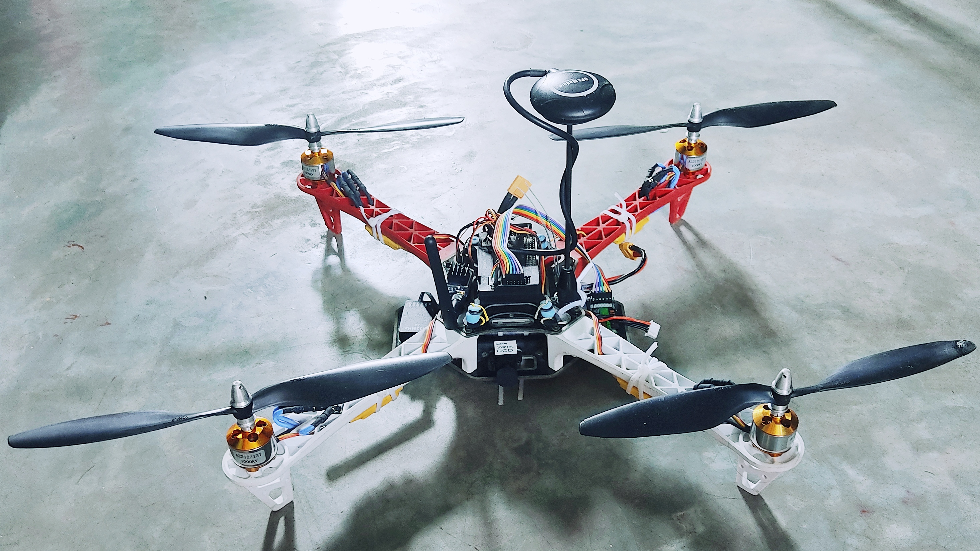
Hardware result
KGEC/CSE/MTECH/2nd YEAR
Outline
Fig 14: Hardware result
July 05th, 2021
Page: 20

Slide 23
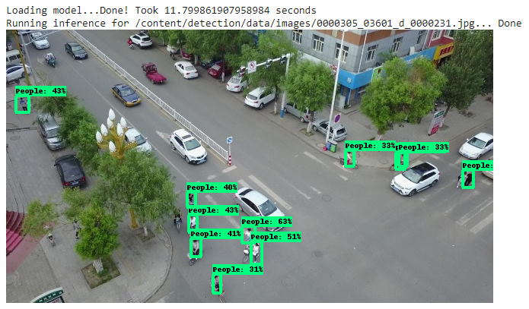
Object detection result
KGEC/CSE/MTECH/2nd YEAR
Outline
Fig 15: Object detection result
July 05th, 2021
Page: 21

Slide 24
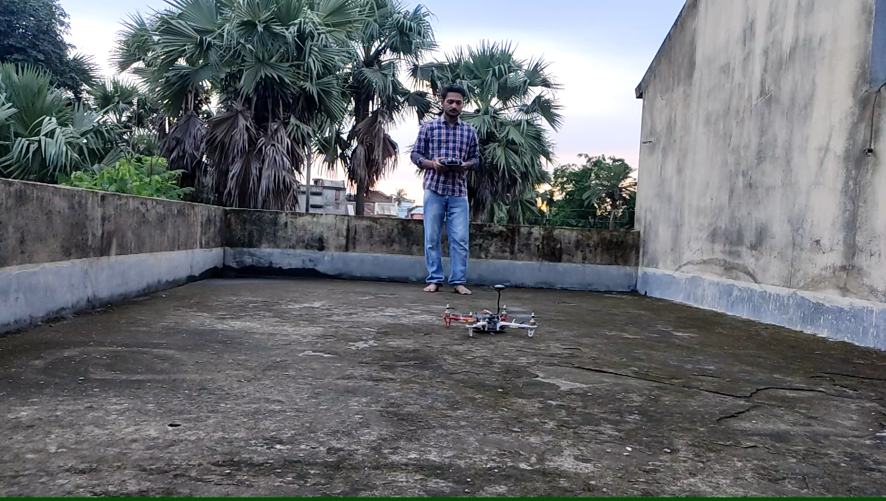
Test Flight
KGEC/CSE/MTECH/2nd YEAR
Outline
Fig 16: Test Flight
July 05th, 2021
Page: 22

Slide 25
Discussion
KGEC/CSE/MTECH/2nd YEAR
Image | 1.jpg | 2.jpg | 3.jpg | 4.jpg | 5.jpg | 6.jpg | 7.jpg | 8.jpg | 9.jpg | 10.jpg
Truth | People | People | No People | People | No People | People | People | People | No People | No People
Predict | People | No People | People | People | No People | People | People | People | People | No People
Table 1: Test image prediction
When an object is present in the image and the model can detect the object, it is called True Positive (TP).
When an object is missing in the figure and the model can detect the object, it is called a False Positive (FP).
When an object is present in the figure but the model fails to identify the object, it is called False Negative (FN).
When an object is missing in the image and the model fails to identify the object, it is called True Negative (TN).
 |  | Actual
 |  | Positive | Negative
Predicted | Positive | TP = 5 | FP = 2
 | Negative | FN = 1 | TN = 2
Table 2: Confusion matrix
Outline
July 05th, 2021
Page: 23

Slide 26
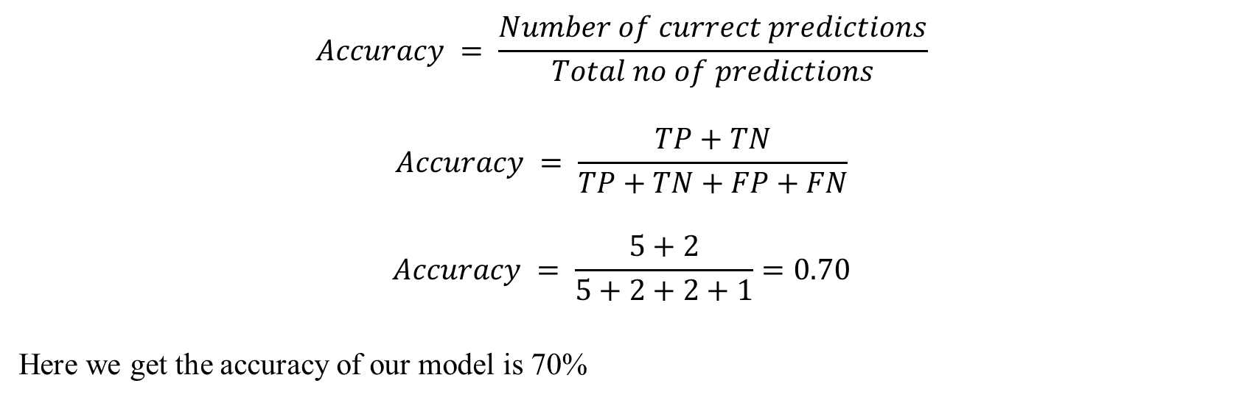
Discussion – contd.
KGEC/CSE/MTECH/2nd YEAR
Accuracy is used to evaluate classification models. Accuracy is the ability to verify that a fraction of predictions are correct for a model or not. Accuracy is not always selected as the best model.
The formula for accuracy is as follows:
$$Accuracy = \frac{Number of currect predictions}{Total no of predictions}$$
$$Accuracy = \frac{TP+TN}{TP+TN+FP+FN}$$
$$Accuracy = \frac{5+2}{5+2+2+1}=0.70$$
Here we get the accuracy of our model is 70%
Outline
July 05th, 2021
Page: 24

Slide 27
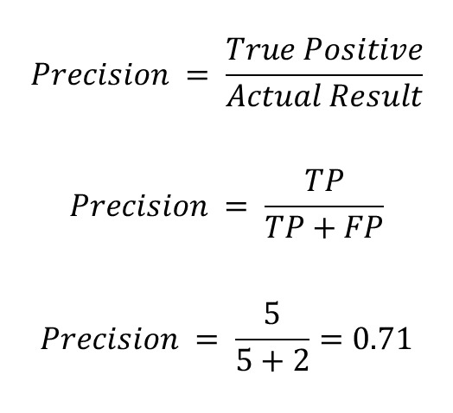
Discussion – contd.
KGEC/CSE/MTECH/2nd YEAR
The number of correct positive predictions made by the model is known as Precision. Following is the Precision formula:
$$Precision = \frac{True Positive}{Actual Result}$$
$$Precision = \frac{TP}{TP+FP}$$
$$Precision = \frac{5}{5+2}=0.71$$
Here we get the Precision of our model is 0.71
Outline
July 05th, 2021
Page: 25

Slide 28
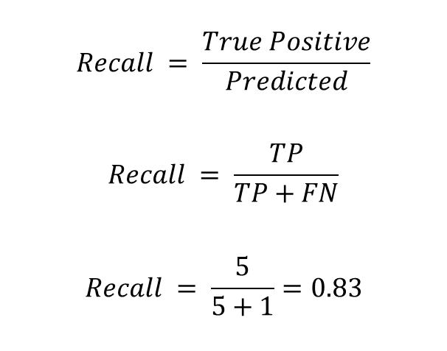
Discussion – contd.
KGEC/CSE/MTECH/2nd YEAR
The number of correct positive predictions made out of all positive predictions made by the model is known as Recall. Following is the Recall formula:
$$Recall = \frac{True Positive}{Predicted}$$
$$Recall = \frac{TP}{TP+FN}$$
$$Recall = \frac{5}{5+1}=0.83$$
Here we get the Recall of our model is 0.83
Outline
July 05th, 2021
Page: 26

Slide 29
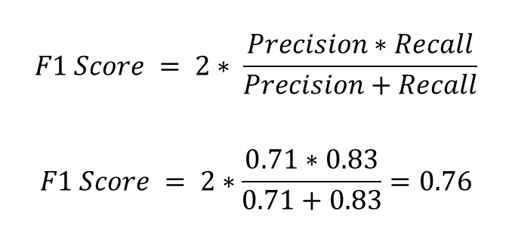
Discussion – contd.
KGEC/CSE/MTECH/2nd YEAR
The other measure is the F1 Score which is a function of Precision and Recall. F1 Score is required when you balance between Precision and Recall. It is a better measure technic over Accuracy. Following is the F1 Score formula:
$$F1 Score = 2∗ \frac{Precision∗Recall}{Precision+Recall}$$
$$F1 Score = 2∗\frac{0.71∗0.83}{0.71+0.83}=0.76$$
Here we get the F1 Score of our model is 0.76
Outline
July 05th, 2021
Page: 27

Slide 30
Conclusion
KGEC/CSE/MTECH/2nd YEAR
This project is based on surveillance. Here a UAV has been made suitable for surveillance of a specific area. We launched this project to monitor from the sky and use UAV surveillance for human detection. With a camera mounted on a UAV, we can capture video and use that video for surveillance.
This is how we decided to finish our project. However, this is not the end because I am very keen to work on this project, so I am willing to do some more work on this project if I get any next opportunity in the future.
Outline
July 05th, 2021
Page: 28

Slide 31
Future work
KGEC/CSE/MTECH/2nd YEAR
Increasing UAV coverage diameter.
Enable 24-hour surveillance even at night.
Camera video footage compression without losing video quality.
UAVs flying in residential areas by generating less noise.
Maximum work with minimum power loss.
Developing UAV controlling software for the ground station.
Outline
July 05th, 2021
Page: 29

Slide 32
References
KGEC/CSE/MTECH/2nd YEAR
Aber, J.S., 2004. Lighter-than-air platforms for small-format aerial photography. Transactions of the Kansas Academy of Science, 107(1), pp.39-44.
SPEARMAN, M., 1978, January. Historical development of world wide guided missiles. In 16th Aerospace Sciences Meeting (p. 210).
Awange, J. and Kiema, J., 2019. Unmanned aircraft vehicles. In Environmental Geoinformatics (pp. 265-289). Springer, Cham.
Blom, J.D., 2010. Unmanned aerial systems: A historical perspective (Vol. 45). Kansas: Combat Studies Institute Press.
Zaloga, S.J., 2011. Unmanned aerial vehicles: robotic air warfare 1917–2007. Bloomsbury Publishing.
Kim, S.J., Jeong, Y., Park, S., Ryu, K. and Oh, G., 2018. A survey of drone use for entertainment and AVR (augmented and virtual reality). In Augmented Reality and Virtual Reality (pp. 339-352). Springer, Cham.
Chen, S., F Laefer, D. and Mangina, E., 2016. State of technology review of civilian UAVs. Recent Patents on Engineering, 10(3), pp.160-174.
Nakazawa, Anton, and Bai Xiang Jin. "Quadcopter Video Surveillance UAV." University of Victoria (2013).
Cox, T.H., Nagy, C.J., Skoog, M.A., Somers, I.A. and Warner, R., Civil UAV Capability Assessment.
Szczepański, C., 2015. UAVs and their avionic systems: development trends and their influence on Polish research and market. Aviation, 19(1), pp.49-57.
Fahlstrom, P. and Gleason, T., 2012. Introduction to UAV systems. John Wiley & Sons.
Outline
July 05th, 2021
Page: 30

Slide 33
Ask me, if you have any questions?

Slide 34
Thank you for your patience and support.

Slide 35
Plagiarism statement
KGEC/CSE/MTECH/2nd YEAR
I check plagiarism from Introduction to conclusion. I used free software named duplichecker. This software can check plagiarism 1000 words at a time.
My report has a total of 8387 words. So I check it 9 times (912, 973, 931, 932, 965, 986, 966, 924, and 798). And results are coming (0, 0, 0, 0, 0, 0, 0, 4, and 4). So the final plagiarism number will be (4*0.924 + 4*0.798)/8.387= 0.821.
July 05th, 2021

